Slide 1
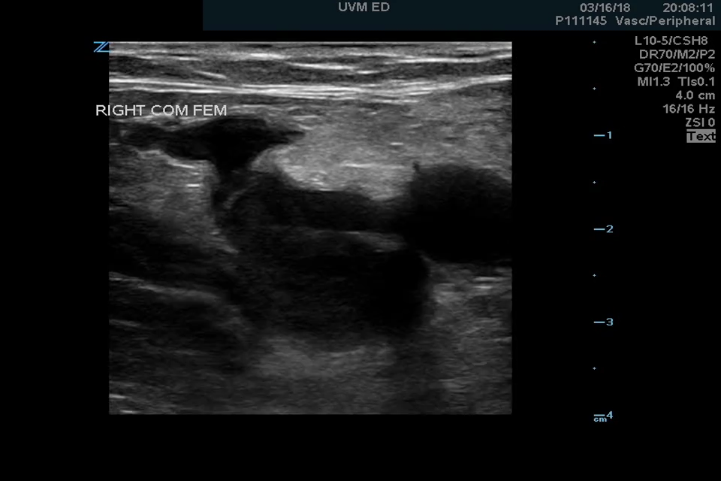
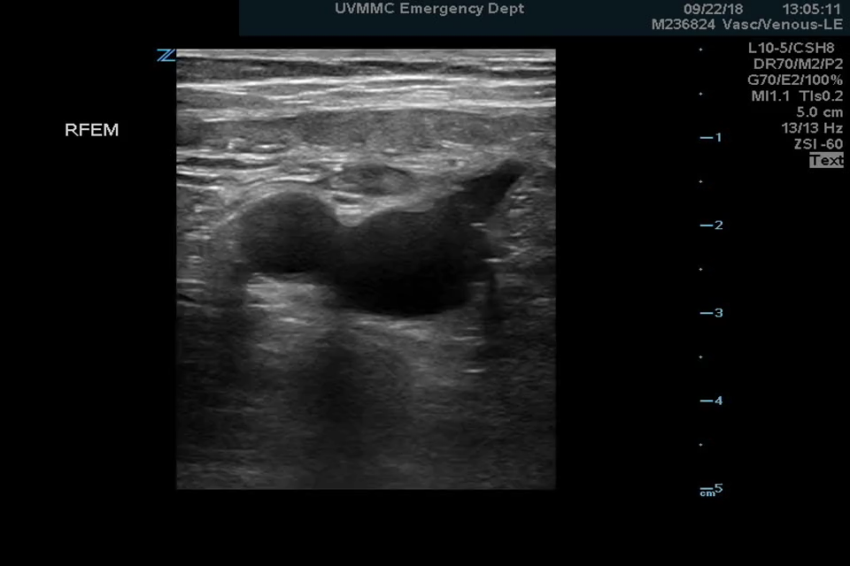
DVT Point of Care Ultrasound

Slide 2
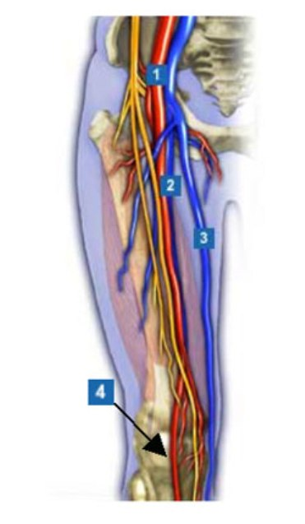
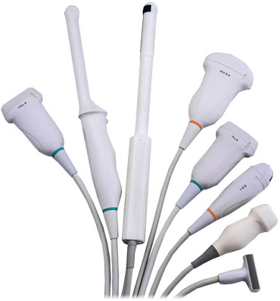
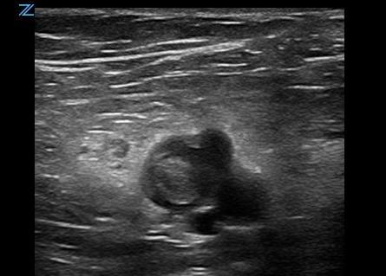
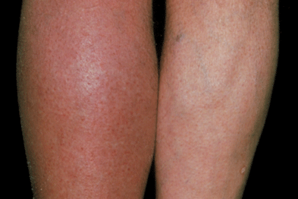

Objectives
Indications for DVT POCUS
Transducer Selection
Basic Vascular Anatomy
Findings of DVT on Ultrasound

Slide 3

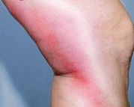
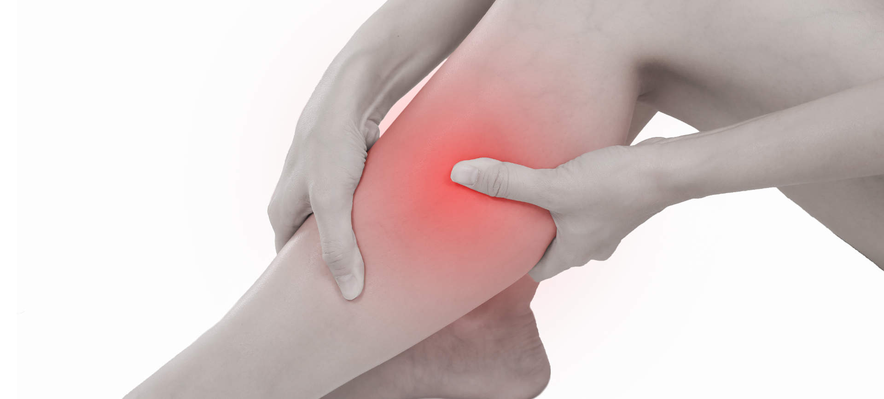
Indications for DVT POCUS
Leg Pain
Leg Swelling
Erythema
Chest Pain/SOB

Slide 4
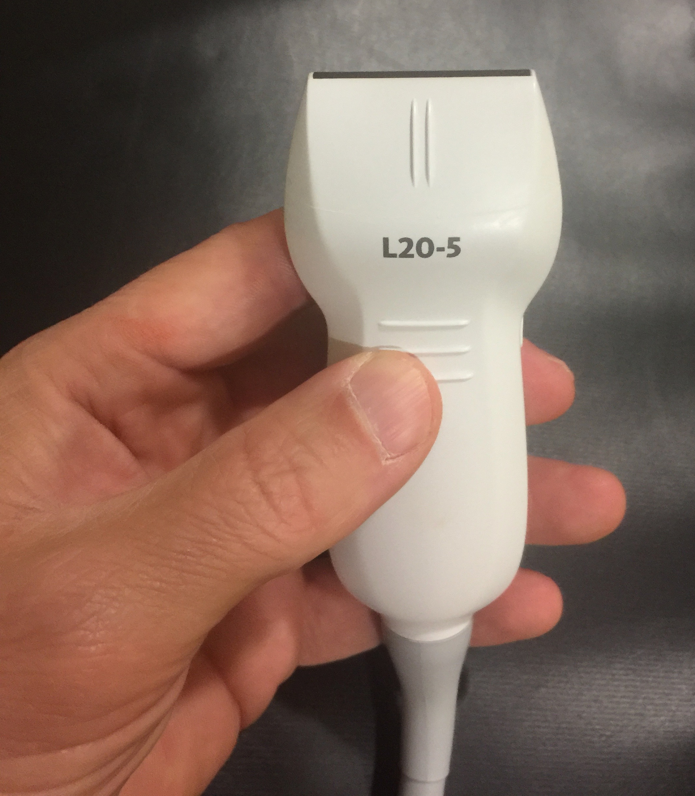
Transducer Selection

Slide 5
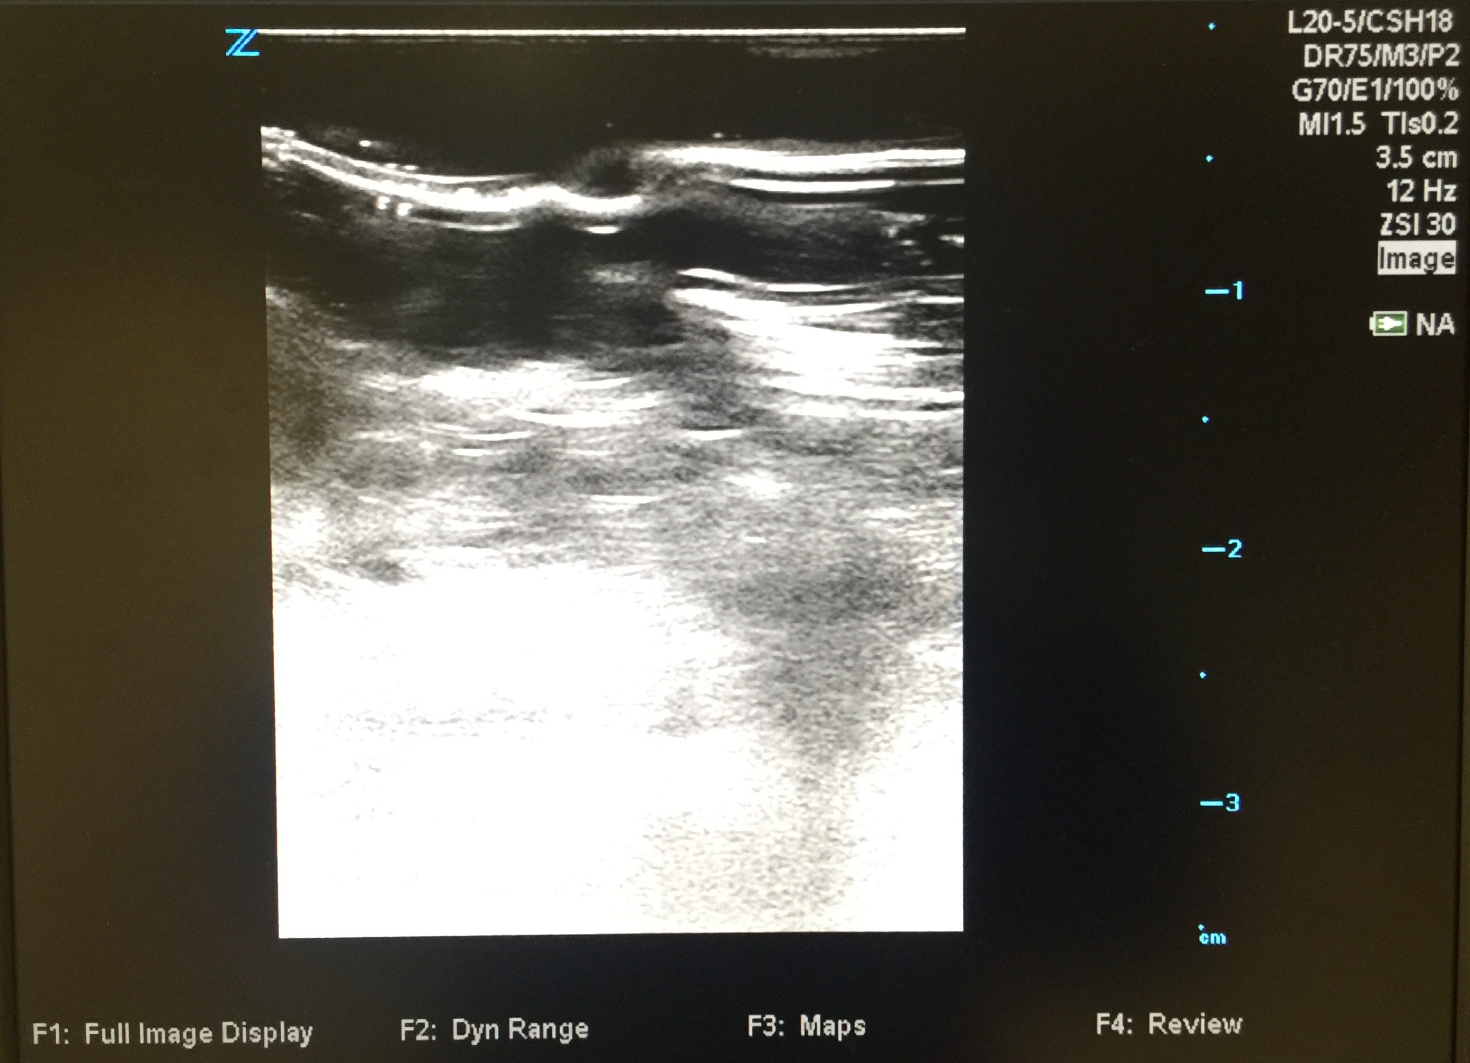
`

Slide 6
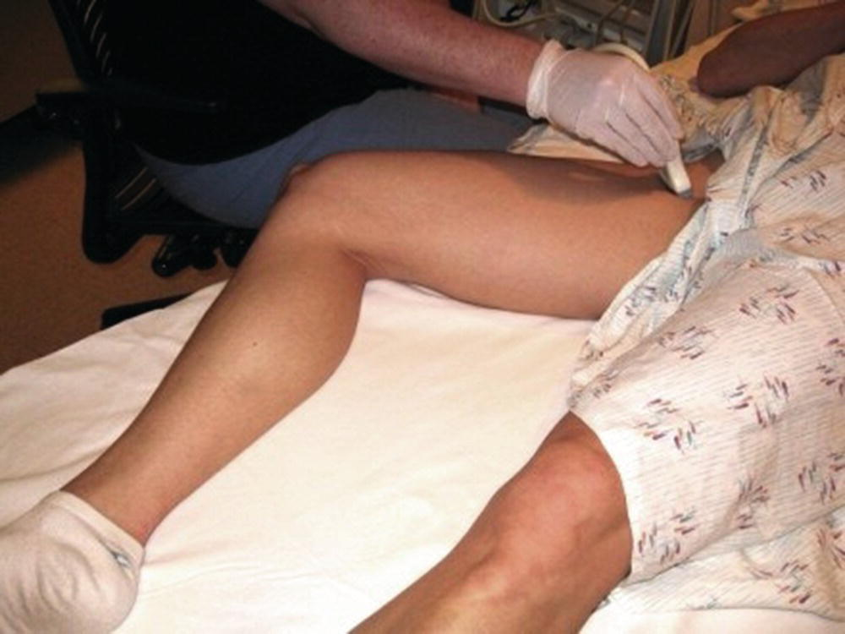
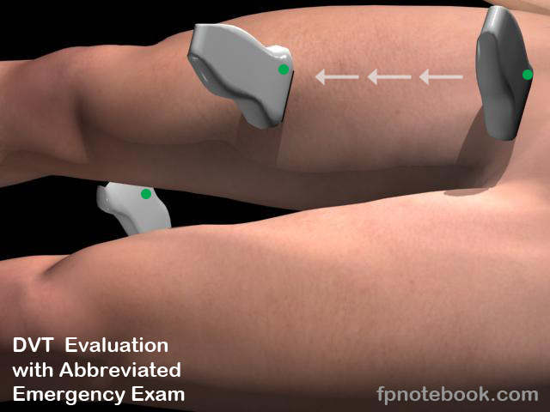
Patient Positioning for DVT POCUS

Slide 7
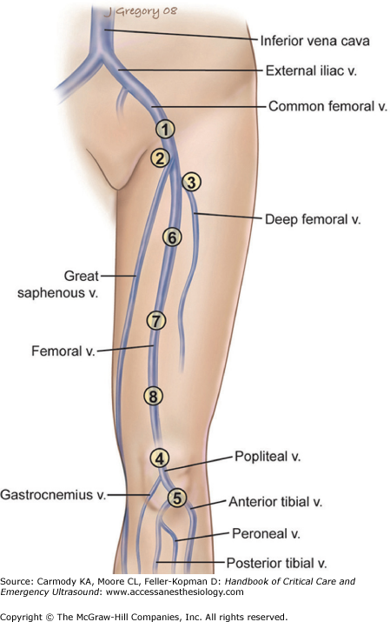
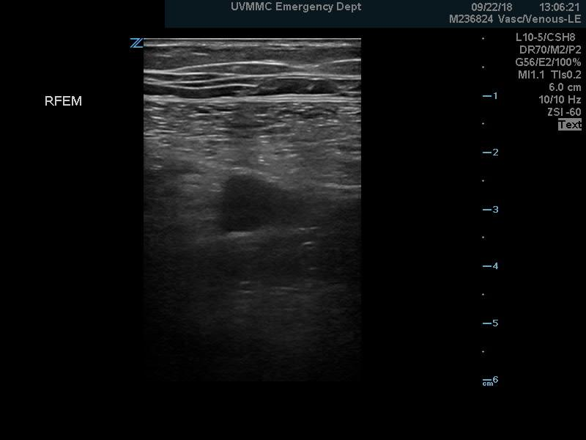
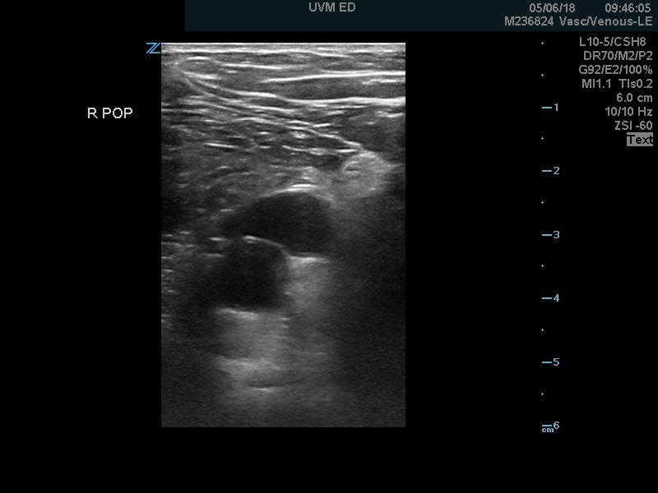
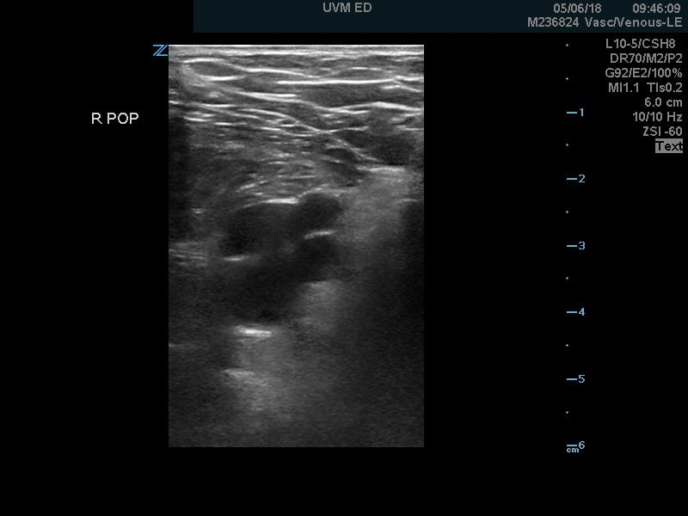
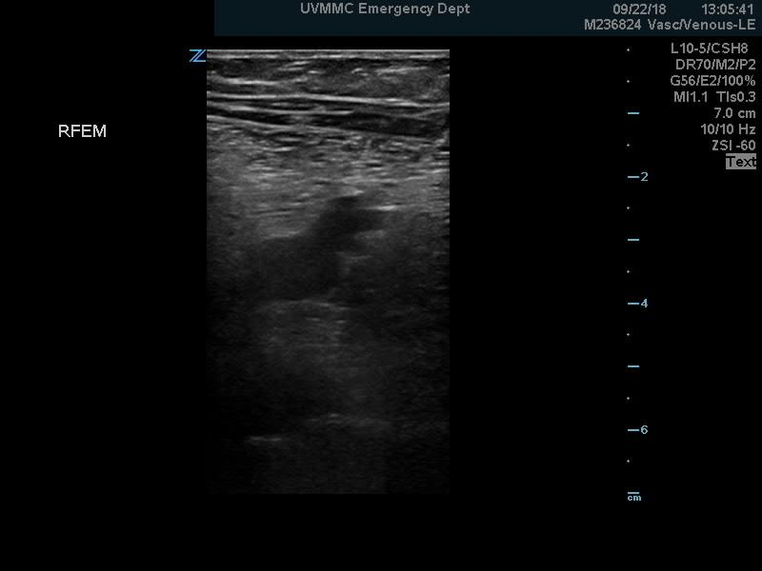
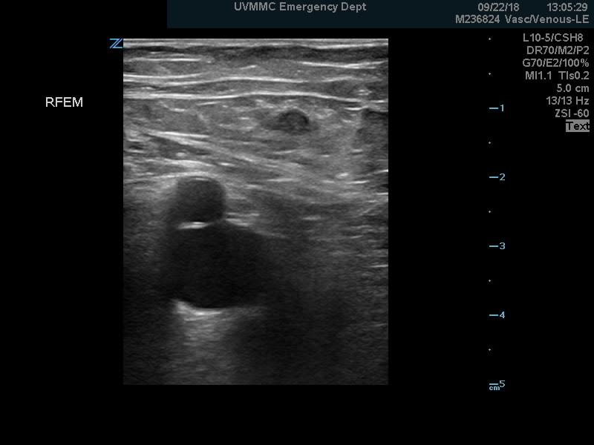

Normal Anatomy
GSV
FV
CFA
FA
PV
V
V
CFV
FV
FV
FV
V
PA
PA
DFV

Slide 8
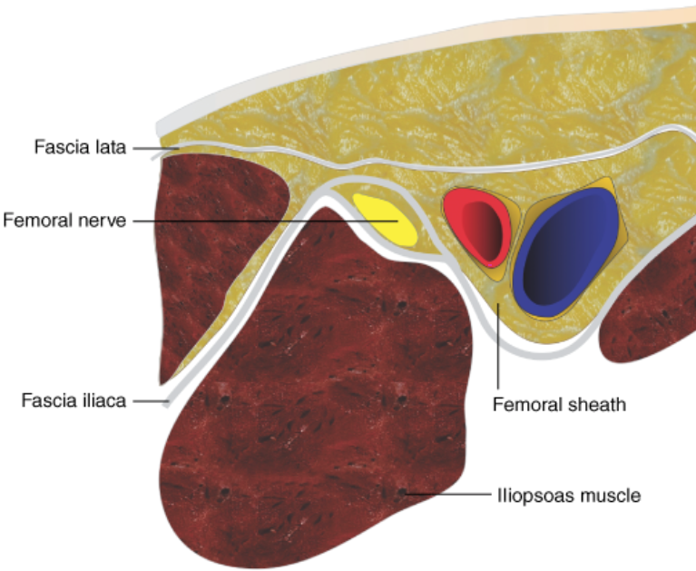
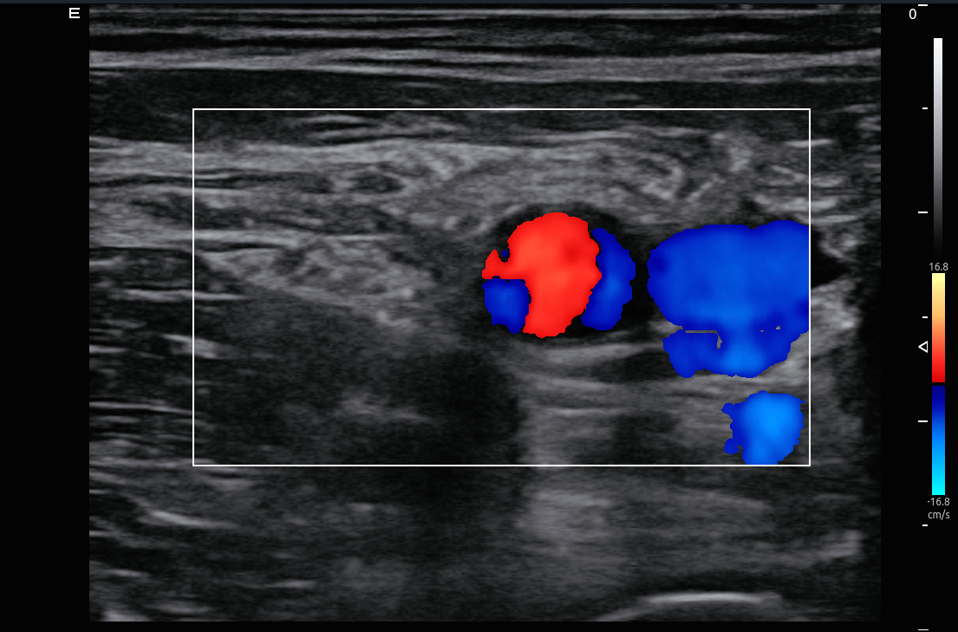
Normal Anatomy

Slide 9
Normal Anatomy

Slide 10
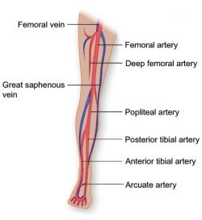
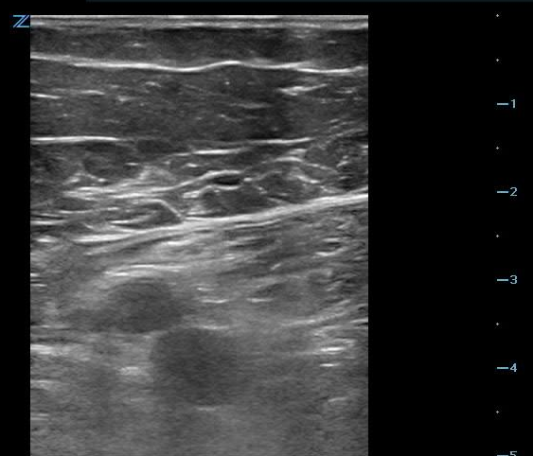
Normal Anatomy
GSV
CFA
CFV

Slide 11
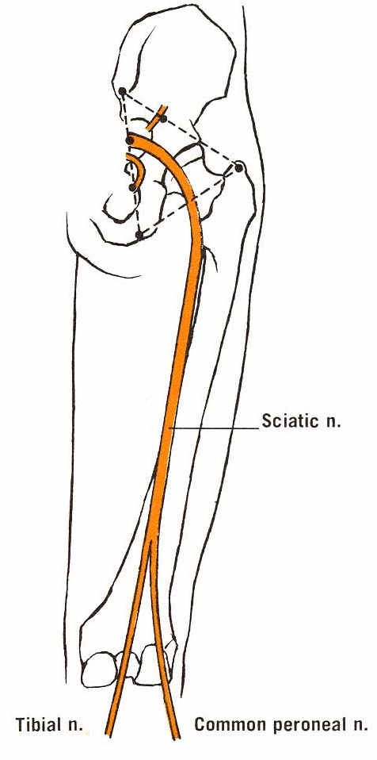
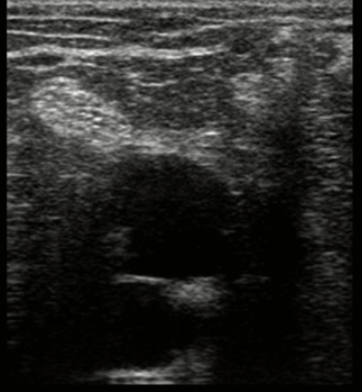
Normal Anatomy

Slide 12
Normal Anatomy

Slide 13
POCUS Evaluation for DVT

Slide 14
POCUS Evaluation for DVT

Slide 15
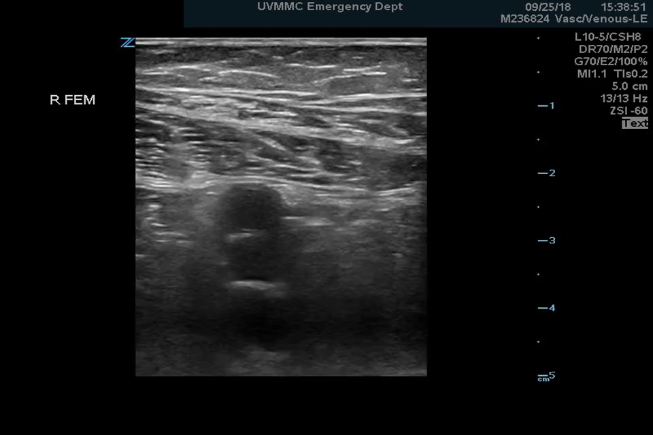
POCUS Evaluation for DVT

Slide 16
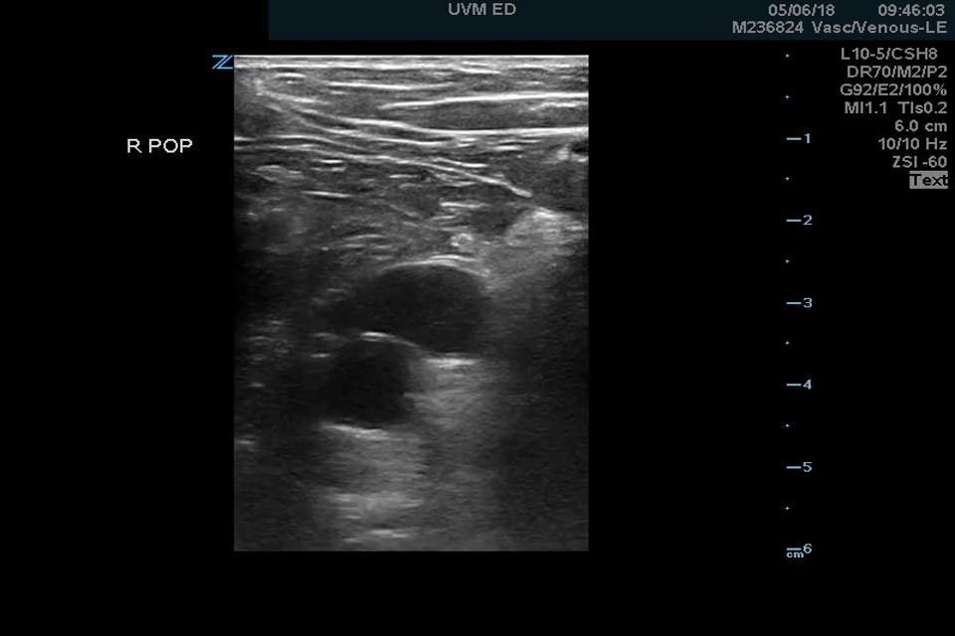
POCUS Evaluation for DVT

Slide 17
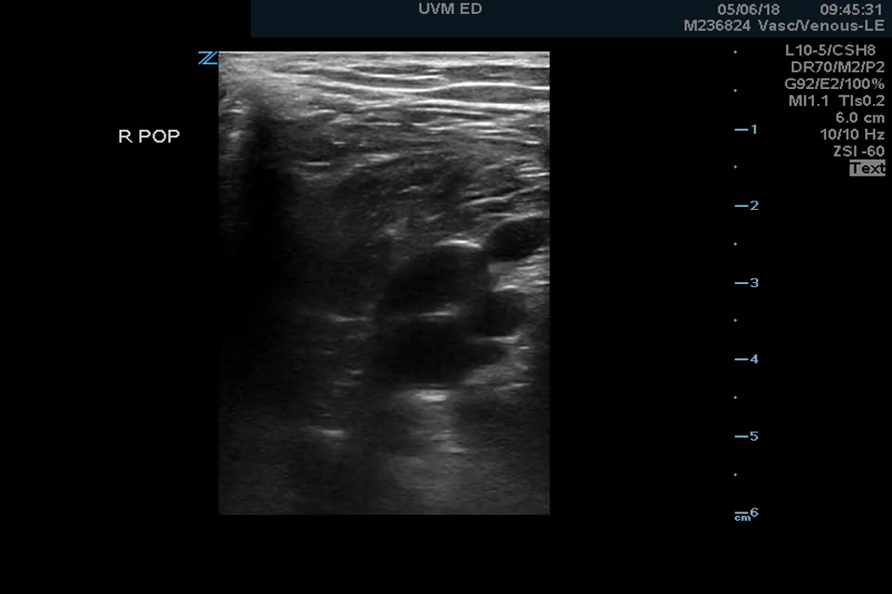
POCUS Evaluation for DVT

Slide 18
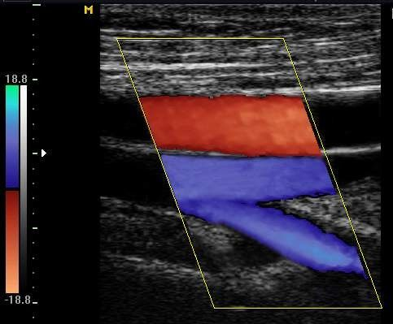
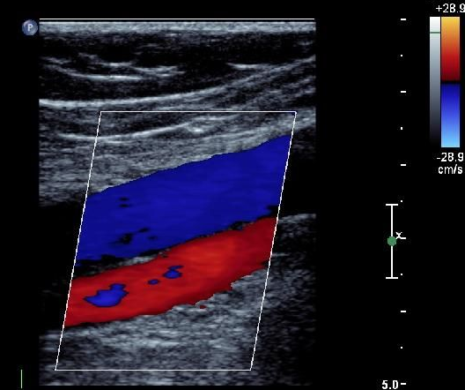
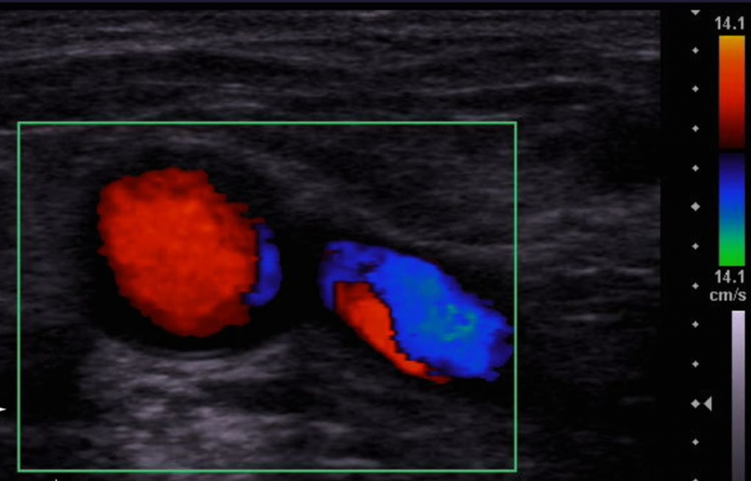
POCUS Evaluation for DVT- Adjuncts

Slide 19
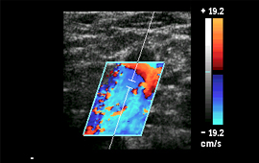
POCUS Evaluation for DVT- Adjuncts

Slide 20
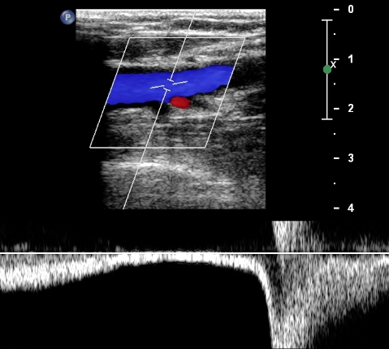
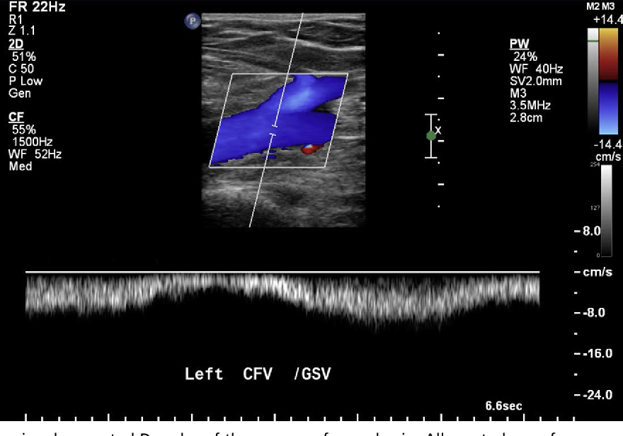
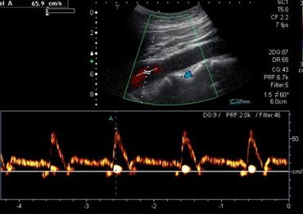
POCUS Evaluation for DVT- Adjuncts

Slide 21
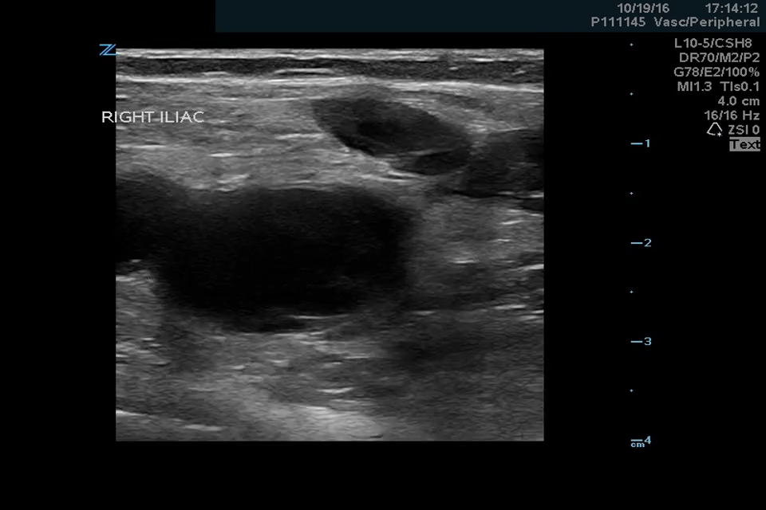
Pathology - DVT

Slide 22
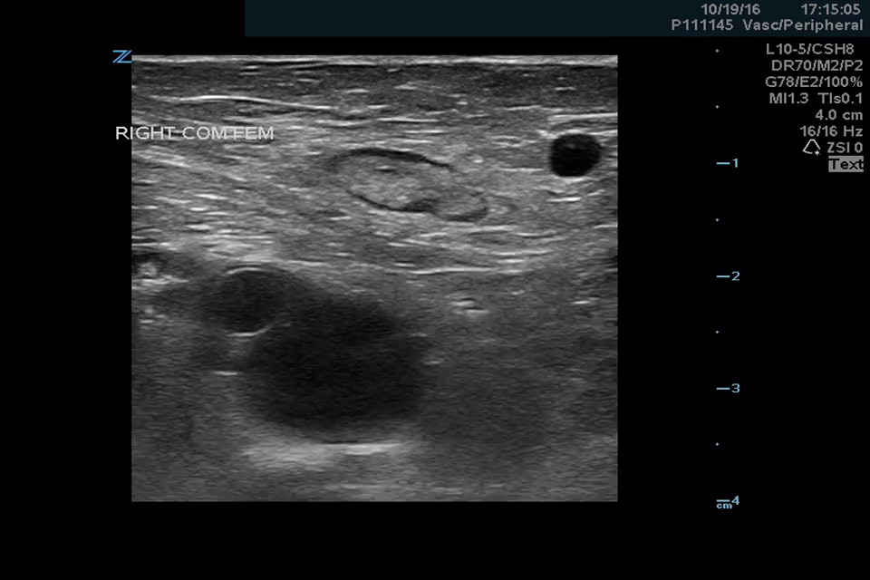
Pathology - DVT

Slide 23
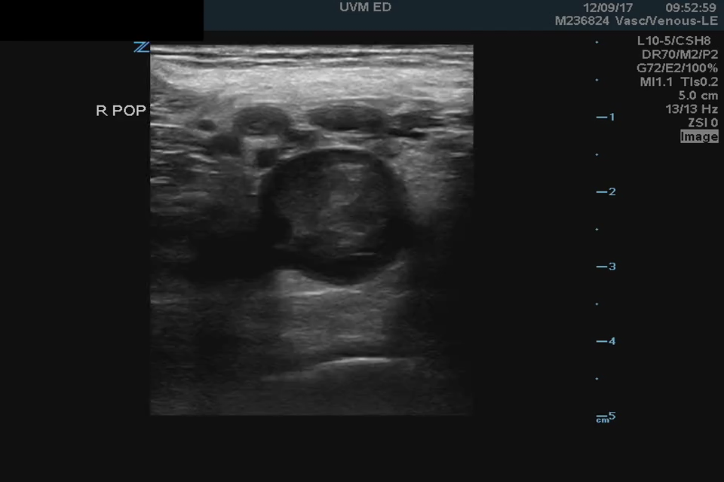
Pathology - DVT

Slide 24
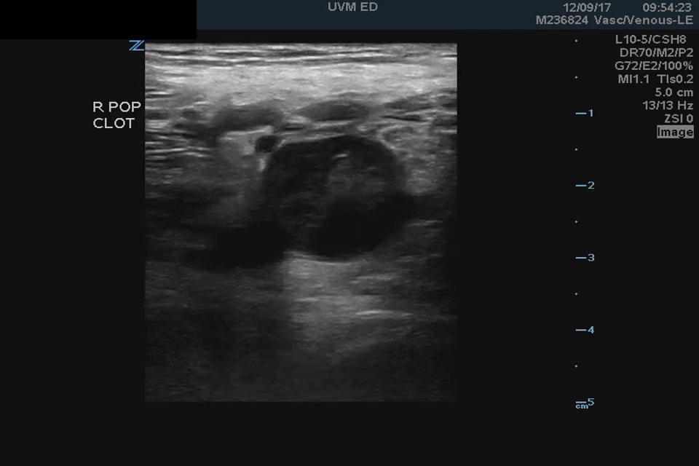
Pathology - DVT

Slide 25
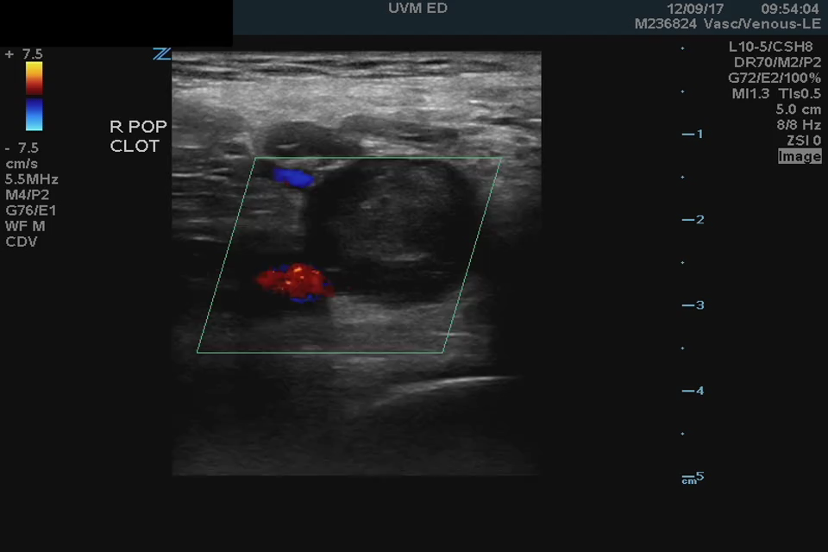
Pathology - DVT

Slide 26
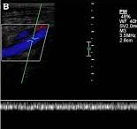
Pathology - DVT

Slide 27
DVT POCUS- Clinical Decision Making
DVT POCUS
TX
+
-
PP
LOW
HIGH
MOD
N/A
D-Dimer
COMP
+/- COMP

Slide 28
DVT POCUS- Cases

Slide 29
DVT POCUS- Cases

Slide 30
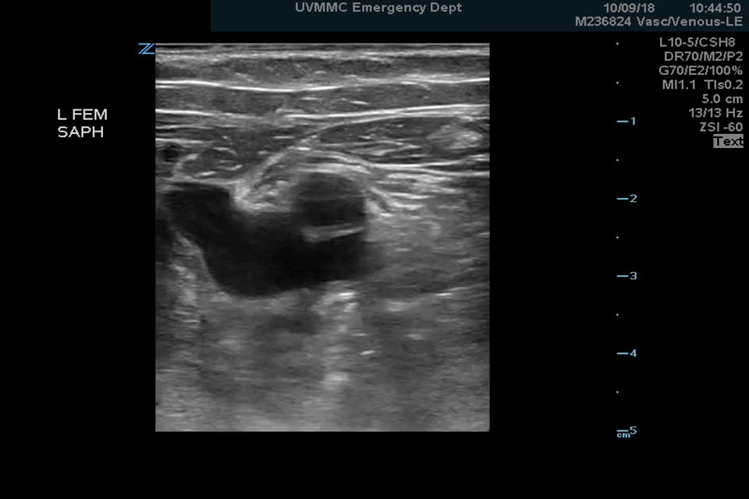
DVT POCUS- Cases

Slide 31
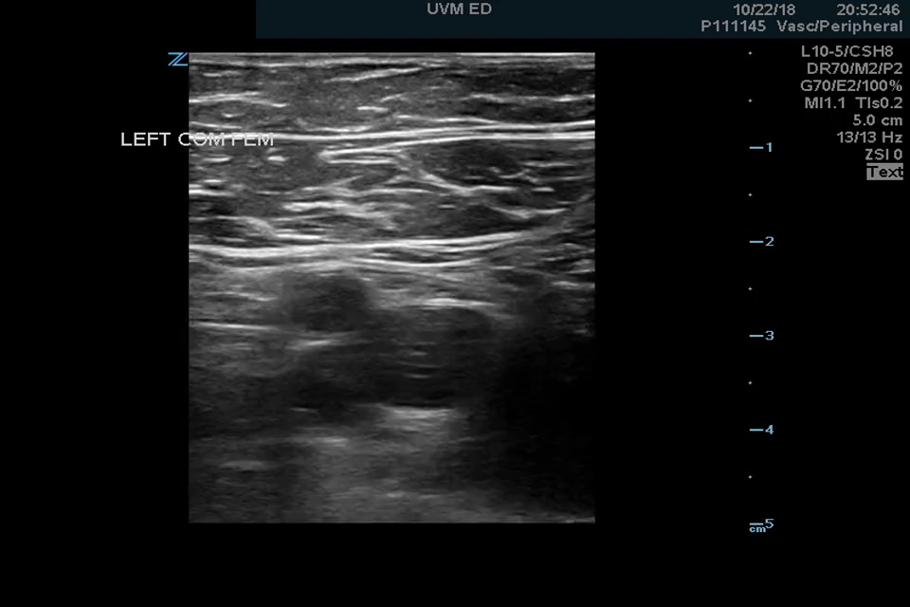
DVT POCUS- Cases

Slide 32
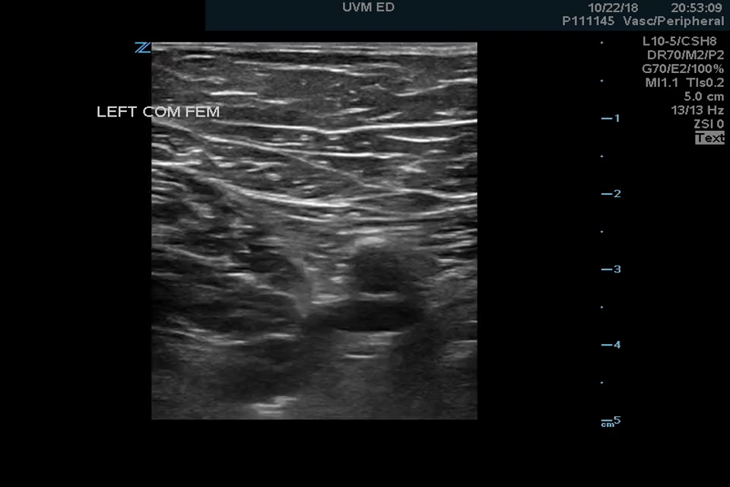
DVT POCUS- Cases

Slide 33
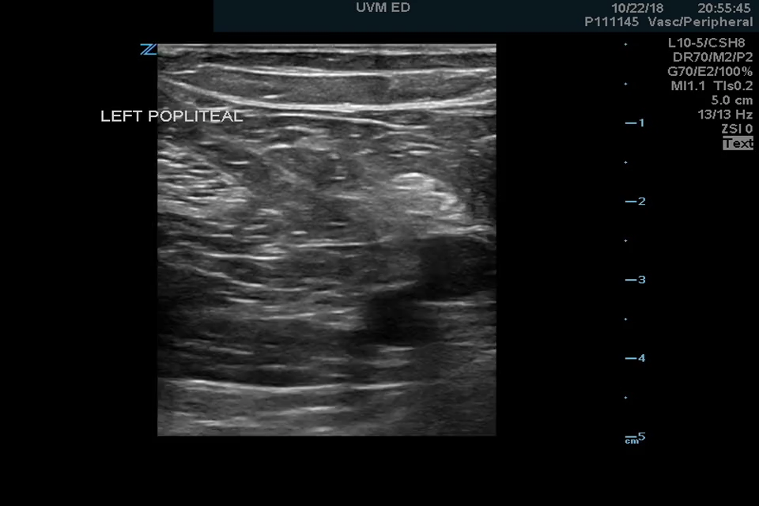
DVT POCUS- Cases

Slide 34
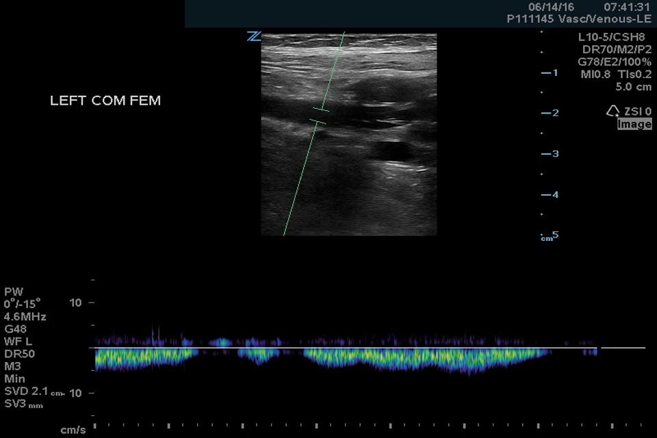
DVT POCUS- Cases

Slide 35
DVT POCUS- Cases
DVT POCUS
TX
+
-
PP
LOW
HIGH
MOD
N/A
D-Dimer
COMP

Slide 36
DVT POCUS- Cases

Slide 37
DVT POCUS- Cases

Slide 38
DVT POCUS- Cases

Slide 39
DVT POCUS- Cases

Slide 40
DVT POCUS- Cases

Slide 41
DVT POCUS- Cases
DVT POCUS
TX
+
-
PP
LOW
HIGH
MOD
N/A
D-Dimer
COMP

Slide 42
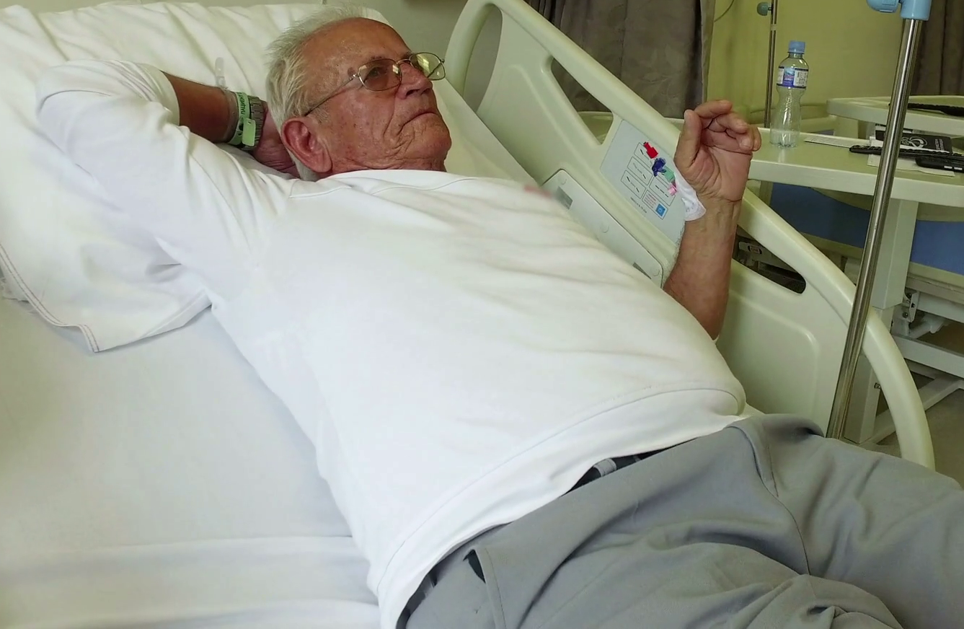
DVT POCUS- Cases

Slide 43
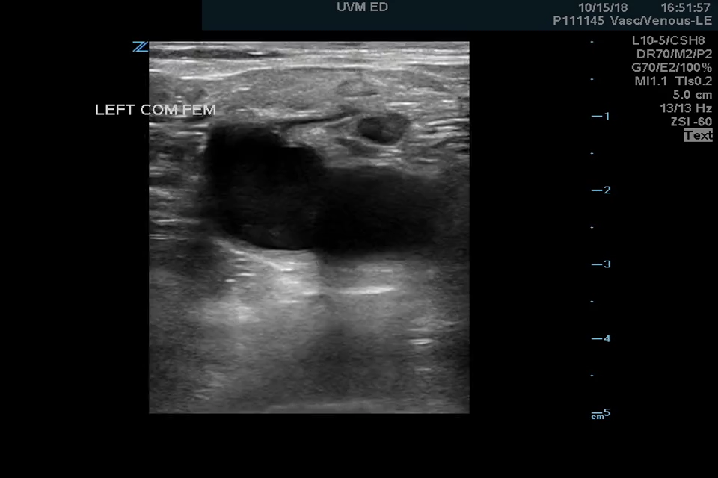
DVT POCUS- Cases

Slide 44
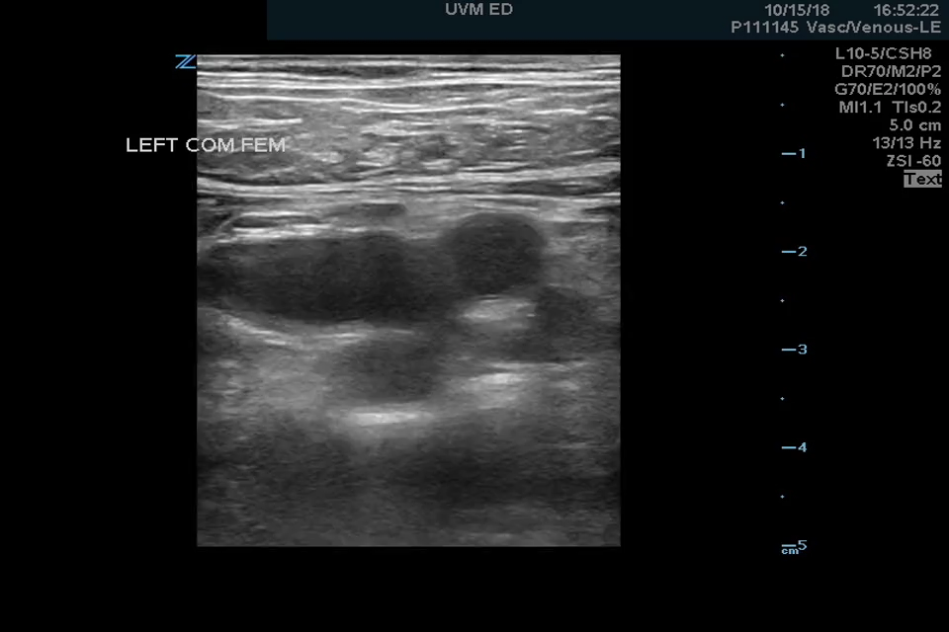
DVT POCUS- Cases

Slide 45
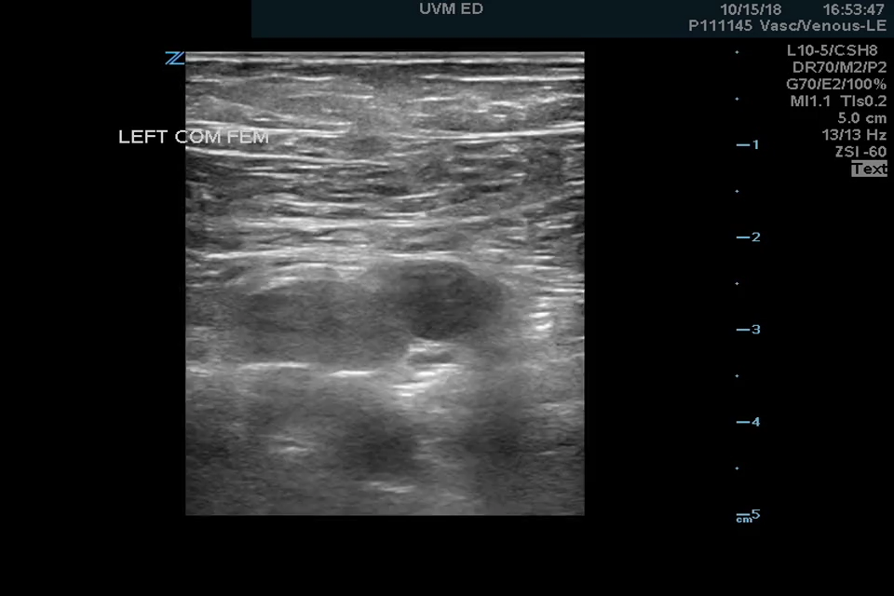
DVT POCUS- Cases

Slide 46
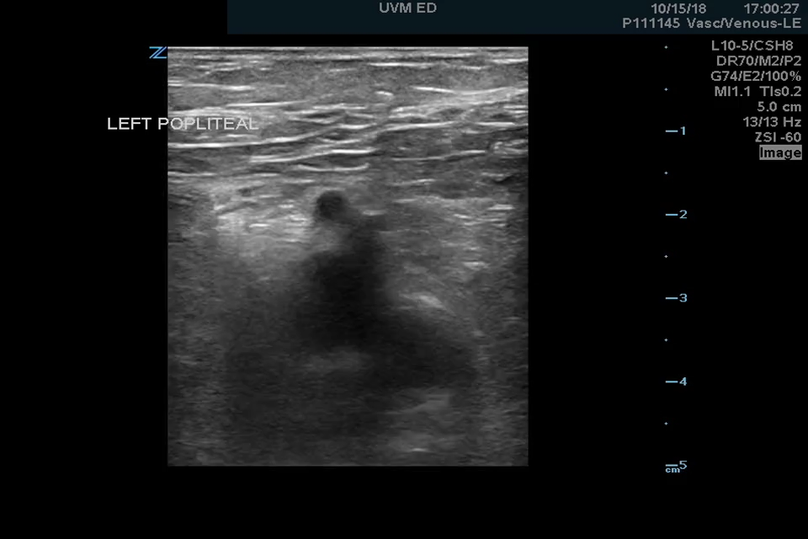
DVT POCUS- Cases

Slide 47
DVT POCUS- Cases

Slide 48

DVT POCUS- Cases

Slide 49
DVT POCUS- Summary

Slide 50
DVT POCUS- Summary
DVT POCUS
TX
+
-
PP
LOW
HIGH
MOD
N/A
D-Dimer
COMP

Slide 51
DVT Point of Care Ultrasound

